Slide 1
BCIS VIII Semester
Strategic Evaluation and Control

Slide 2
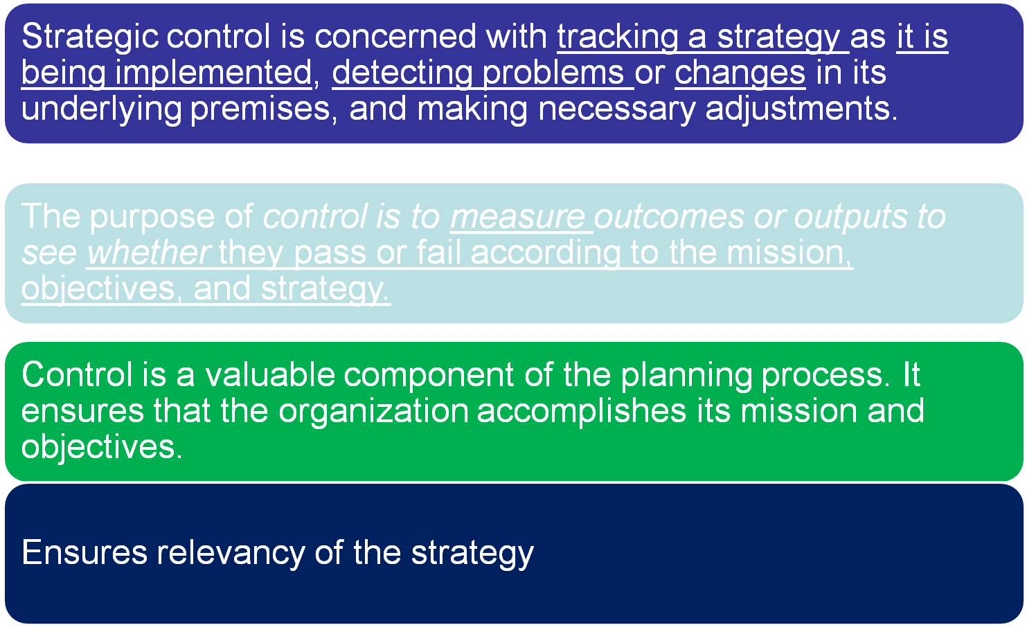
Concept of evaluation and control in strategic management

Slide 3
Strategic and Operational Control
Strategic Control | Operational Control
Exercised by TOP Level Corporate Executives | Exercised by Functional Level Executives
Focus on Long Term | Focus on day to day operations
Observation and monitoring at a long period horizon | Day to day observation and monitoring
Environmental scanning, SWOT matrix, information gathering techniques will be used | Day to day reporting, comparing standard Vs Actual functional performance
Overall concentration focused like: External and internal | Confined with internal mostly
Basic question: are we moving in right direction based on vision statement | Basic question shall be asked: How are we performing .. All depts.
Strategic Audit is performed: Assessment of vision, mission, and strategies | Internal audit: Assessment of all departmental activities…

Slide 4
Evaluation and Control Process
Does performance match standard ?
Determine what to measure
Establish predetermined standard
Measure performance
No
Take Corrective action
Yes
Stop

Slide 5
Types of Strategic Control
Premise Control: Every strategy is based on certain planning premises—assumptions or predictions. Premise control is designed to check systematically and continuously whether the premises on which the strategy is based are still valid or not.
Premises or assumptions are:
Organizational factors: resource availability both financial and managerial
Industrial factors: industry structure, competitive position and growth
Environmental factors: market condition, regulations, …

Slide 6
Types of Strategic Control
2. Implementation Control: Regular monitoring the strategic implementation and find out the any non compliances and solve them. Implementation control is designed to assess whether the overall strategy should be changed in light of results. Focused on actual process of strategy implementation.
Two Methods:
Monitoring strategic thrust: For eg. new product development status and result
Milestone review: critical activities are assessed that has strong effect

Slide 7
Types of Strategic Control
3. Strategic Surveillance: Strategic surveillance is designed to monitor a broad range of events inside and outside the firm that are likely to affect the course of its strategy. The basic idea behind strategic surveillance is that important yet unanticipated information may be uncovered by a general monitoring of multiple information sources.
4. Special Alert Control: A special alert control is the thorough, and often rapid, reconsideration of the firm's strategy because of a sudden, unexpected event. It works with contingency plan.

Slide 8
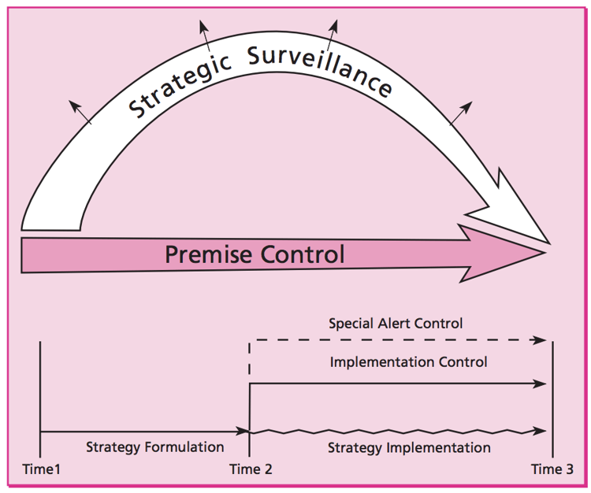

Slide 9
Types of Strategic Control
Generally there are three types of control
Input Controls: Focus on controlling resources such as skills, knowledge, abilities, values and motives of employees.
Behaviour controls: Such controls are established to control the activities that generate the performance. They specify how something is to be done through policies, rules, standard operating procedures and orders from superior.
Output controls: Focus on actual performance results through qualitative and quantitative control measures.
Other types of control are: …….

Slide 10
Criteria for strategic evaluation
Consistency
Consonance i.e. responsive to the internal and external envt.
Feasibility
Advantage
Characteristics of strategic evaluation
Provides direction
Continuous activity
Top management activity
Cost effectiveness
Focus on key performance
Future oriented

Slide 11
Guidelines for proper evaluation and control
Economical
Timeliness
Provide true picture
Action oriented
Foster mutual understanding, trust and common sense
Simple
Convincing

